Slide 1
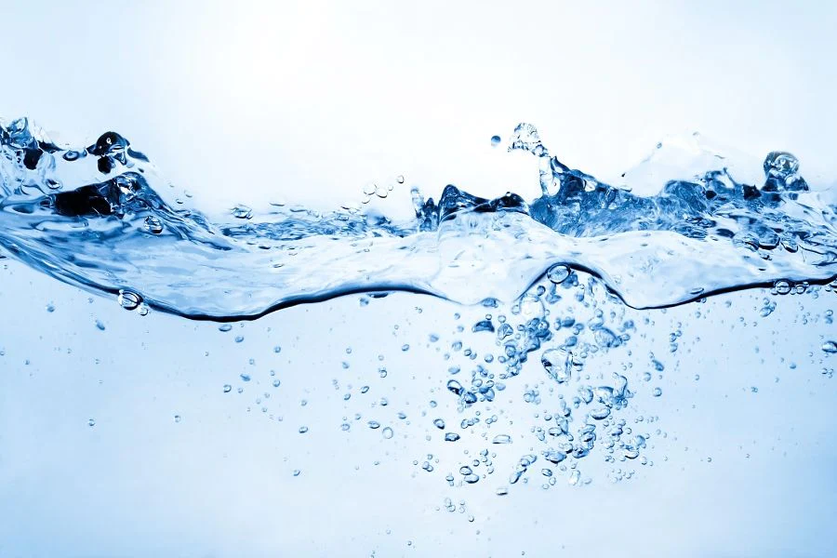
DSMA Group Assignment
Group 10
Anjaneya Sarangi
Jatin Dhawan
Sharath Chandra Paladugu
Sowmya Chattragadda
Virendra Singh

Slide 2
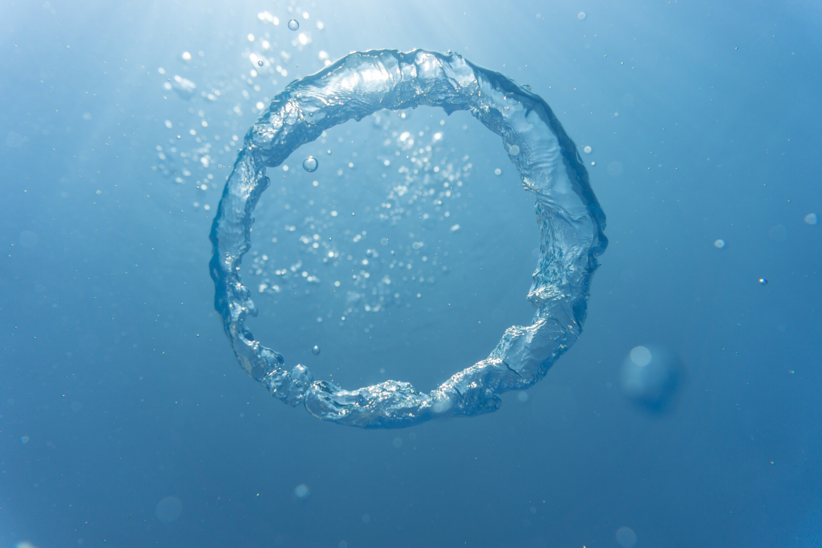
Contents
About Alkaline Water
Competition Landscape
Understanding Customer Intent
Finding Our USP – ActivePure Alkaline Water
Competition GTM
ActivePure Marketing Plan

Slide 3

About Alkaline Water
The “alkaline” in alkaline water refers to its pH level. A pH level is a number that measures how acidic or alkaline a substance is.
Alkaline minerals in alkaline water, such as calcium, potassium, magnesium, or iron, determine its pH.
Benefits of Alkaline Water
pro-aging properties
colon-cleansing properties
immune system support
hydration, skin health, and other detoxifying properties
weight loss
cancer resistance
Water that’s naturally alkaline occurs when it passes over rocks — like springs — and picks up minerals, which increase its alkaline level.
Commercially OTC alkaline water is produced through a chemical process called electrolysis.
Alkaline water market exists in three categories mainly Bottled Alkaline Water, Electrolytes IV and Alkaline Water Purifier.

Slide 4
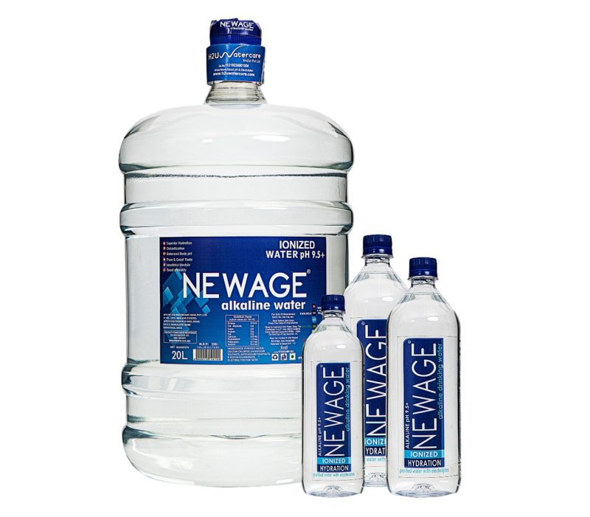
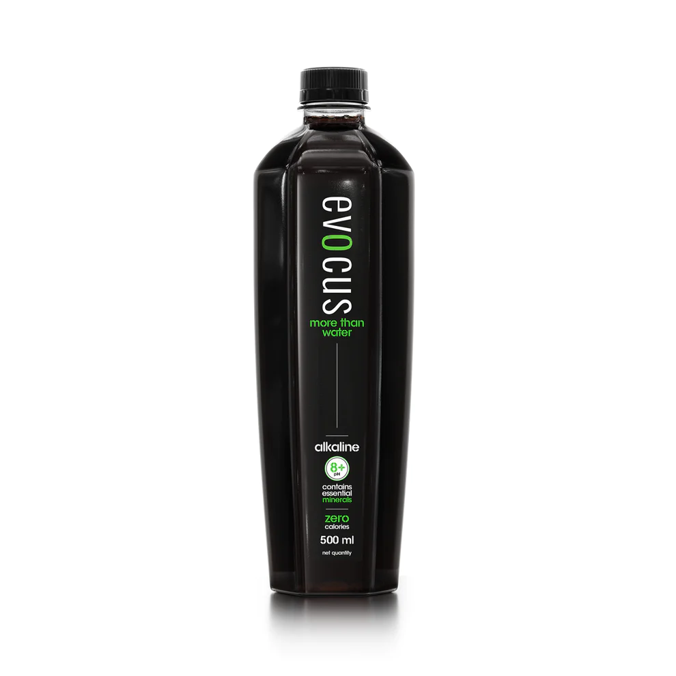
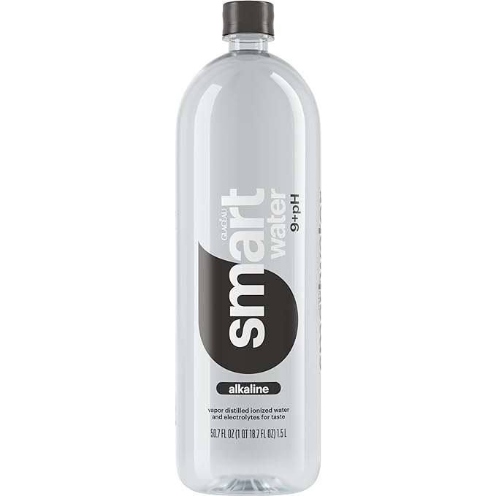
Competition Landscape
Evocus
Glaceau Smart Water
NewAge Alkaline Water
Currently market leader in India in the bottled Alkaline water
Operating Model – Omnichannel. D2C, B2C and B2B
Product Differentiation – The black color differentiates from the rest indicating presence of extra minerals and nutrients.
Being projected as premium product as lot of celebs are papped using this product.
Other Products include Hydration solutions, Normal Mineral water as well
Strategic focus on Brand Collaborations and Brand Placements
Alkaline Water product from
Operating Model – Omnichannel. D2C, B2C and B2B
Product Differentiation – Natural alkaline water
Currently market leader in India in the bottled Alkaline water
Operating Model – Omnichannel. D2C, B2C and B2B
Product Differentiation – Alkaline water for daily use

Slide 5
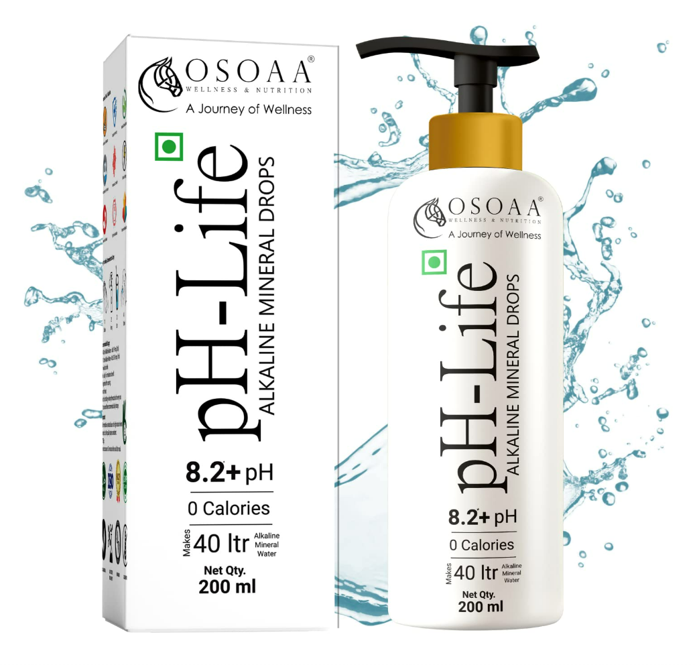
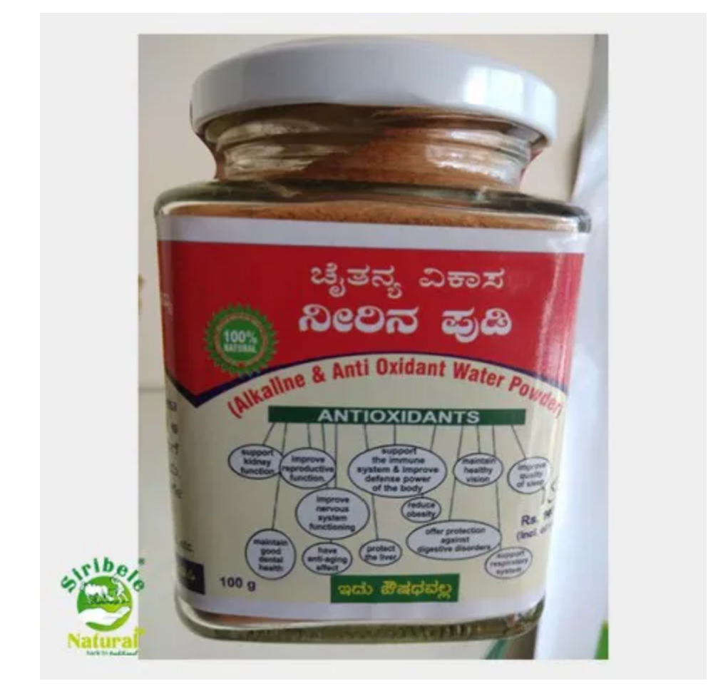
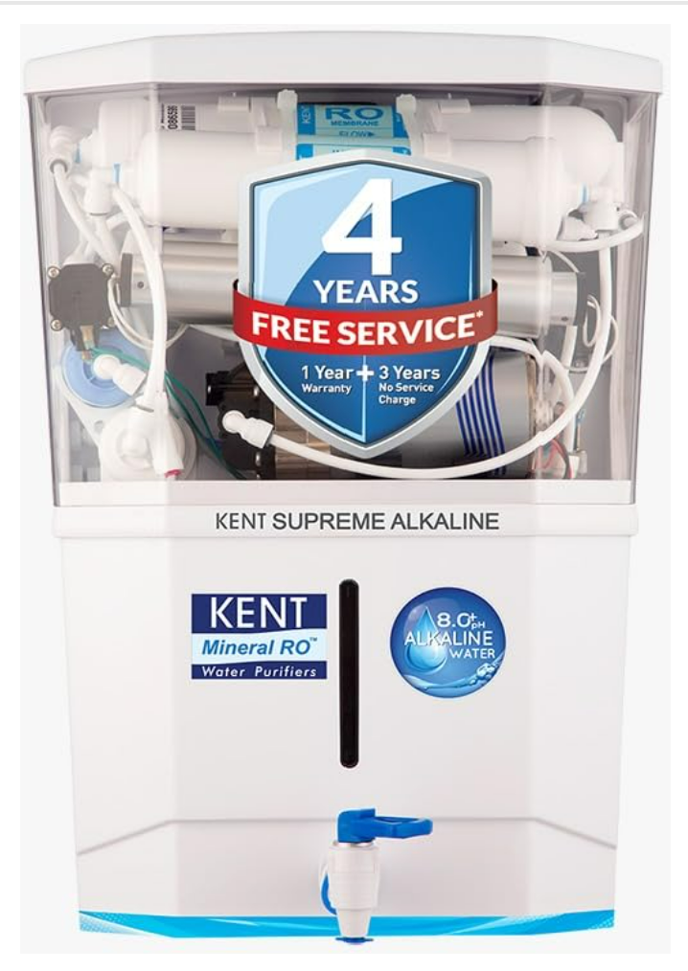
Indirect Competition
Alkaline Water Drops
Cost Effective
Percieved more as medication rather than a lifestyle change
Alkaline Water Powder
Cost Effective
Not Ready to Drink – Hassle of preparation before every drink
Alkaline Water Powder (Purifier)
Not an actual Alkaline Water
No added minerals in the water
No style statement / lifestyle change associated

Slide 6
Understanding Customer Intent
Using the keyword search analysis being done by users on the internet
Informational
Alkaline water benefits
Alkaline water safety
Commercial
Alkaline water bottle
Best alkaline drink
Transactional
Buy alkaline water
Alkaline water online
Alkaline water price
Alkaline water colour
Celebrity water drink
What is alkaline water
How to make alkaline water
Right drinking water pH
Alkaline mineral water
Top alkaline water companies
Natural alkaline water
Alkaline beverages
Cheap Alkaline water
Hydration products
Best Alkaline water price
Alkaline water subscription
Where to get alklaine water
Alkaline water delivery
Alkaline water near me
Buy healthy water
Active Alkaline Water
Alkaline water for sports

Slide 7
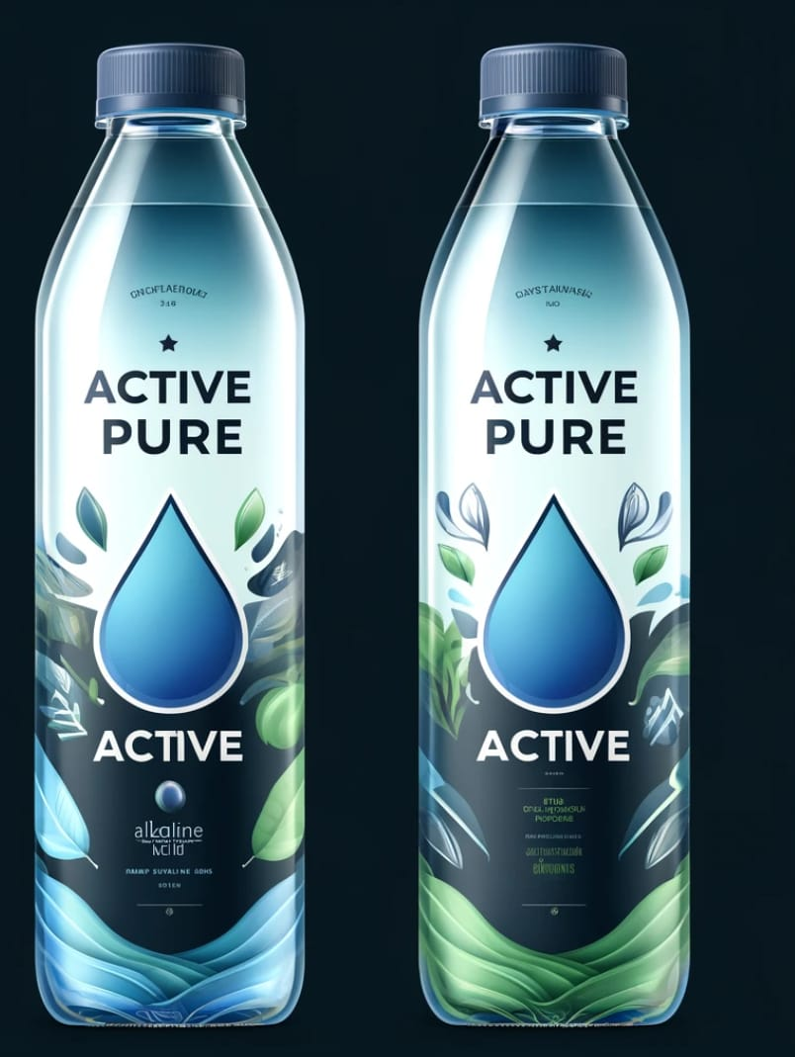
Premium Quality Alkaline Water based Sports Drink for Enhanced Hydration, Energy and Well-being
Finding Our USP
While the current "Alkaline water" pitch is all about its health benefits and consumer inquiries about its efficacy, a strong area of interest seems to be emerging from the sports/physical activities application of the Alkaline water. Hence potential niche could be "Alkaline Water for Sportpersons and Athletes".
This niche would target consumers who wants to supplement their regular sugar/caffeine based drinks with a healthier, nutrient rich, natural premium-quality alkaline water Based on the analysis of consumer intent and niche identification, the unique selling proposition (USP) of the alkaline water product could be:
Our Brand

Slide 8
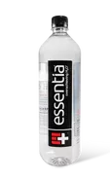
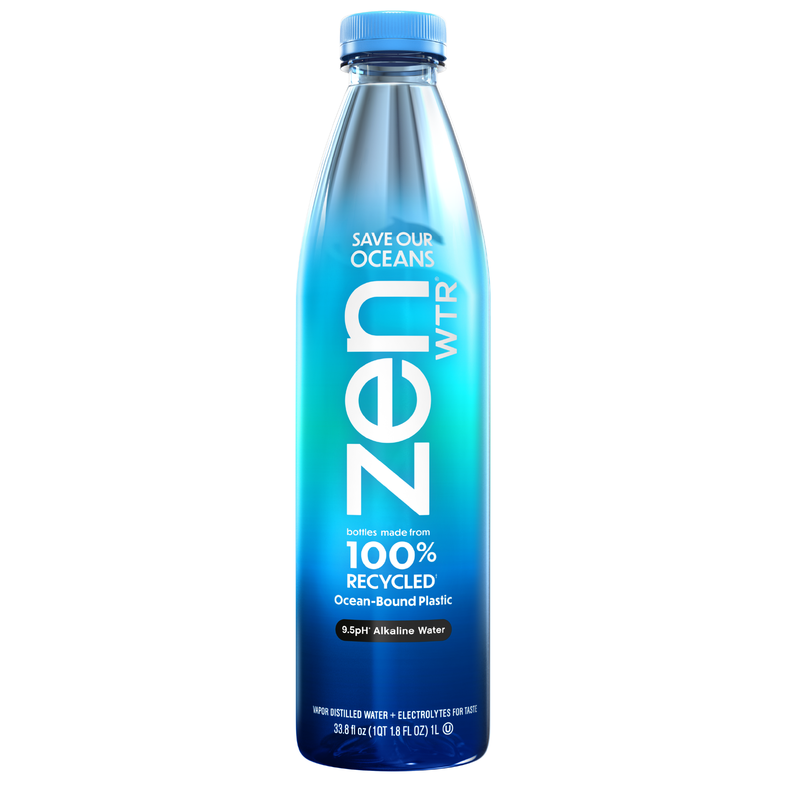
Competition GTM Strategy
India Market: Only a few limited players are operating in this category, hence the competition is not very aggressive at current. Focus of all the brands is to create a category first and then compete with each other hence, most of the positioning is on overall benefits of alkaline water. However, one brand that is completely dominating the Indian market at present is Evocus.
US Market: In US, the category has got matured enough and there are multiple brands which are competing against each other. Primarly the two topmost brands are Essentia and ZenWTR.
Evocus' mission is to redefine hydration. They believe hydration is more than just drinking water—it's about replenishing your body with essential minerals and electrolytes
Essentia's mission is to improve lives through Essentia Hydration and inspire people everywhere to do the things that matter most to them.
ZenWTR's core mission is to reduce pastic pollution in the oceans. They claim to be world's first plastic negative water bottle brand and saving ocean ecology is their prime purpose.

Slide 9
Competition Analysis: Evocus
Primary Organic Keyword ranking is focusing around anchor keyword "Black Water"
Top Organic keywords include "Indian Black Water", "buy black water", "alkaline black water"
SEM
Not much being invested in SEM – Very Limited Ads running
Social Media Marketing
Very Impactful Instagram presence with core strategy on Collaboration Marketing with similar audience influencers
Amazon Marketing Services
SEO
Huge Investments in getting top positions on marketplaces like Amazon/Flipkart.
Clear Intent to target only Purchase-Ready customers.
Affliate Marketing
No Affliate marketing existence found on common channels like Gpay, CRED, PhonePe etc.
Organic Influencer Marketing
Evocus has been successful in positioning itself more than an alkaline water – but a healthy lifestyle status symbol
Lot of Celebs are spotted using the product which has given organic endorsements to the brand

Slide 10
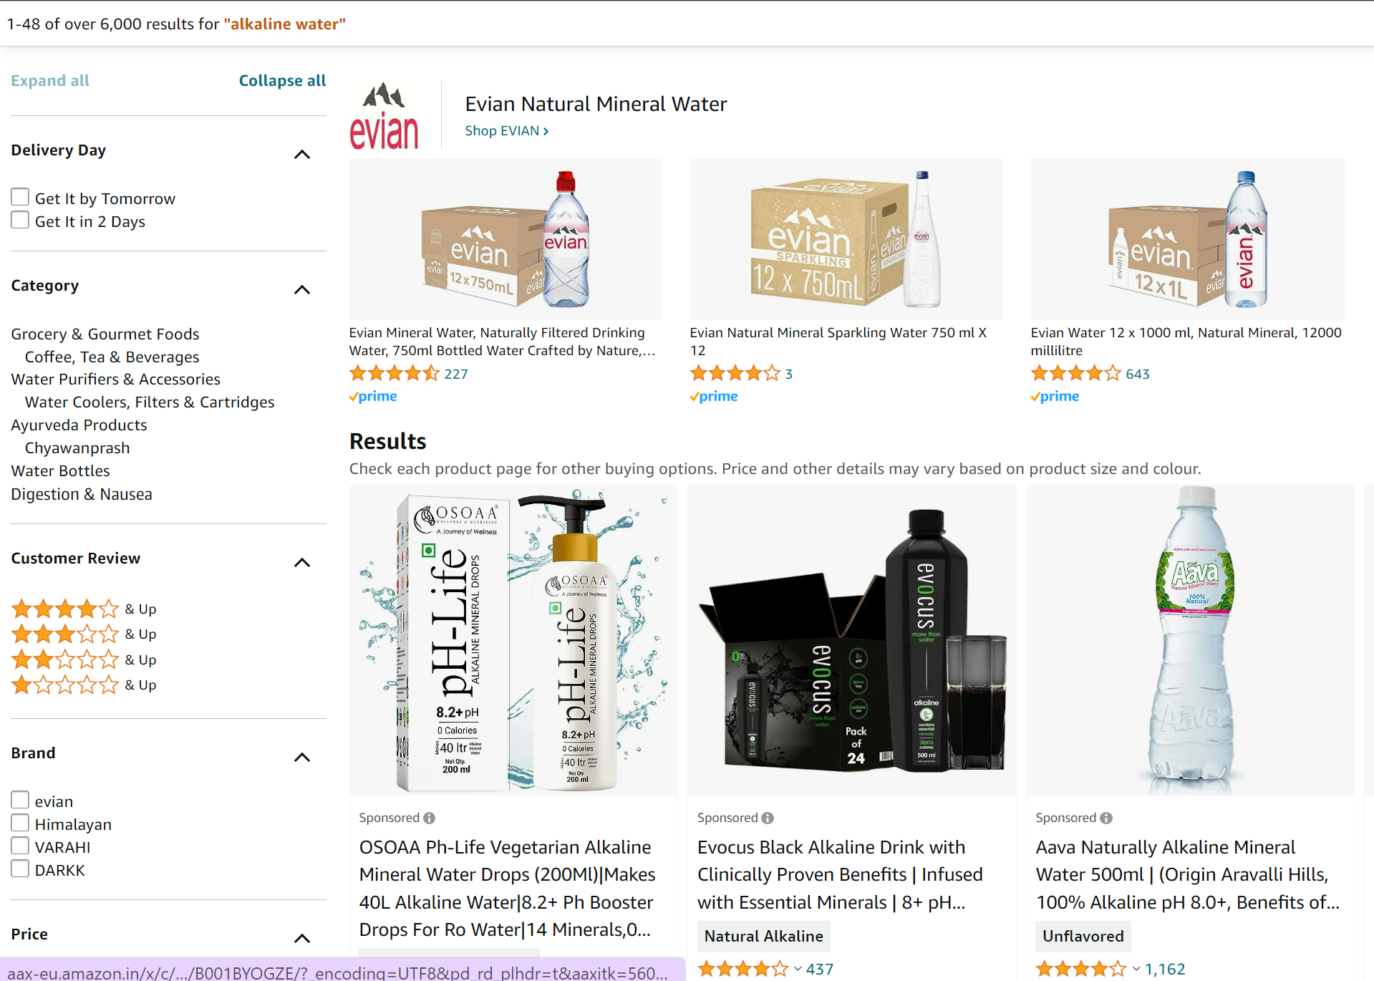
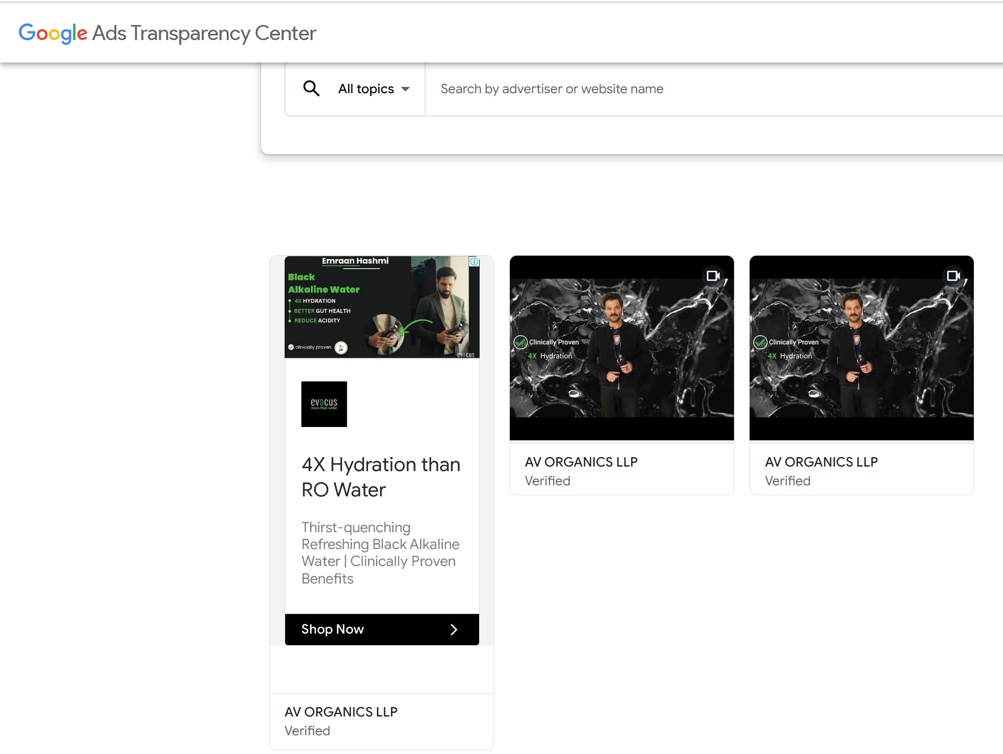
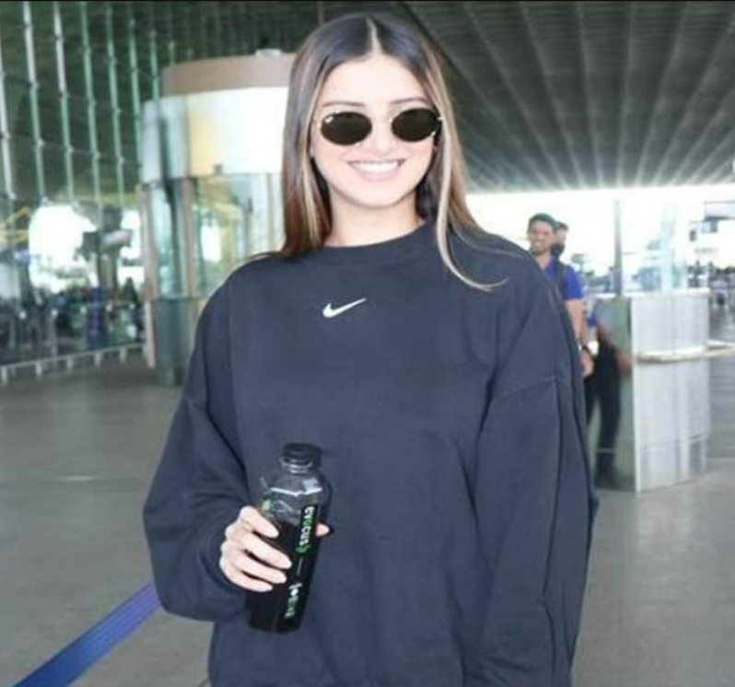
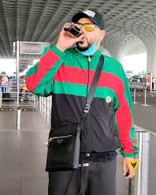
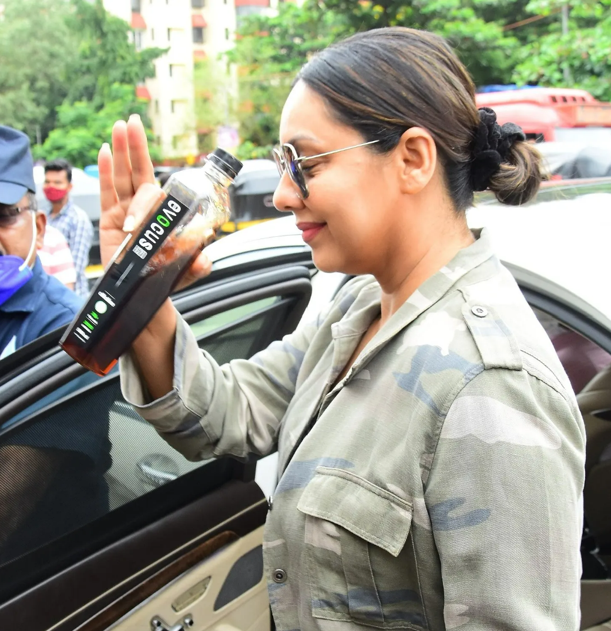
Evocus Marketing In Action
Amazon Marketing Services: Evocus is present at almost all top searches related to alkaline/natural/black water
SEO/SEM:
Not Strategic focus on SEO/SEM. No Transactional/Commercial keywords in Google Top 10. Very Less ads on SEM as shown above.
Influencers Mouth of word:
Due to its premium nature and health benefits – lot of celebs are papped with organic usage of product which has helped the brand.

Slide 11
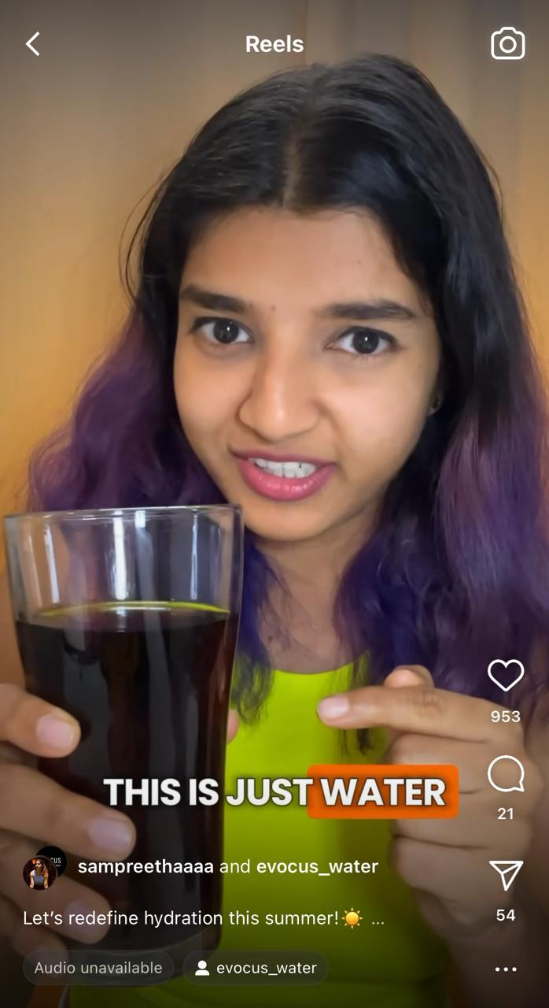
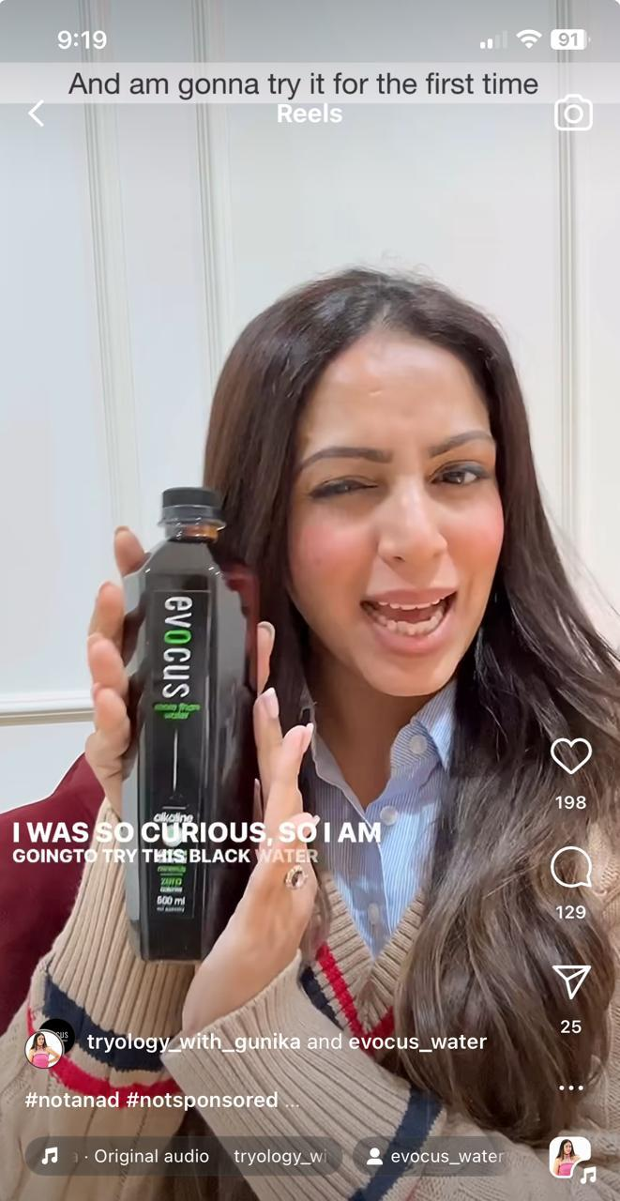
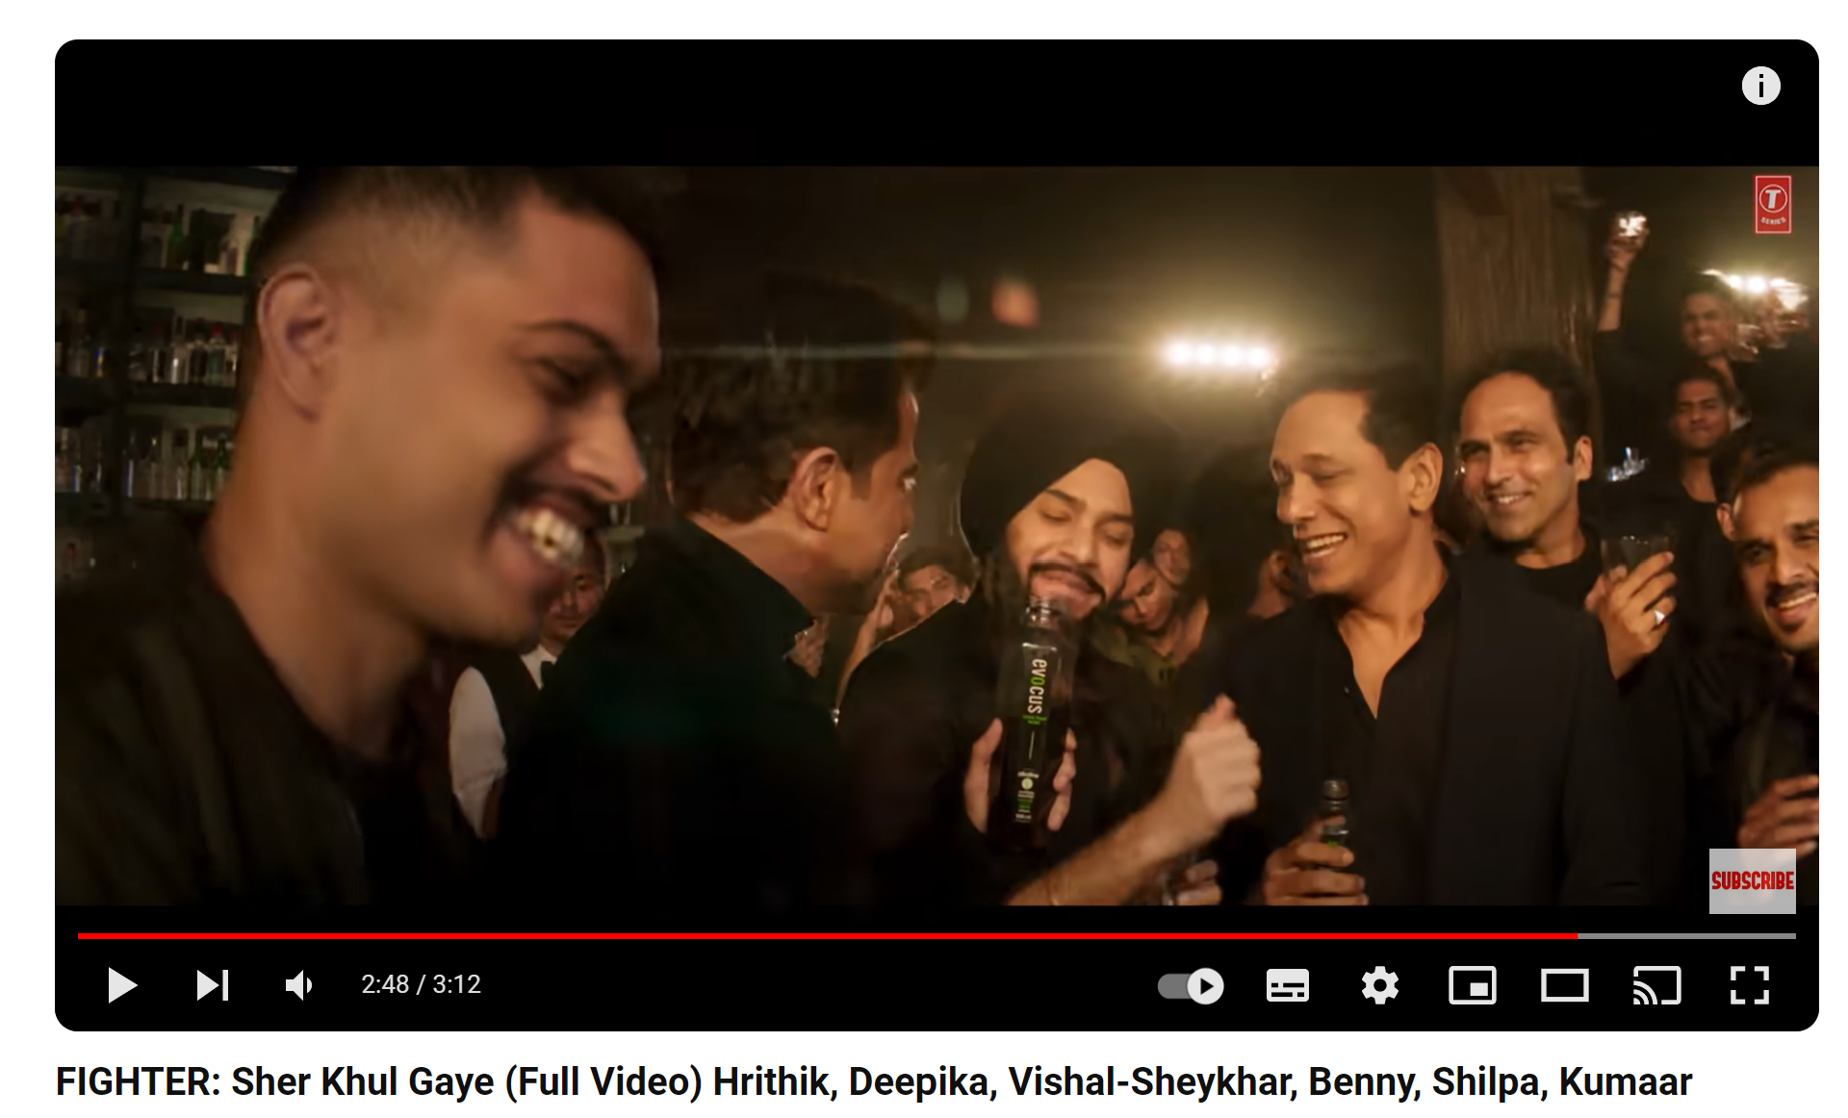
Evocus Marketing In Action
Instagram Influencers Collaboration: Evocus is partnering with multiple IG Influencers in its social media strategy.
Product Placement:
Evocus is partnering with multiple production houses in brand placements in strategic scenes for maximum messaging impact.

Slide 12
ActivePure Alkaline Water - GTM
Segmentation
Target
Positioning
Demographic Segmentation:
Age: Target individuals aged 18-45, particularly those actively engaged in sports and fitness activities.
Gender: Both males and females interested in sports and fitness.
Income: Middle to high income earners who prioritize health and fitness.
Psychographic Segmentation:
Health-conscious individuals seeking natural and premium products.
Athletes and sports enthusiasts looking for better hydration options to enhance performance.
Environmentally conscious consumers who prefer sustainable products.
Behavioral Segmentation:
Regular gym-goers, athletes, and fitness enthusiasts.
Consumers who are willing to pay a premium for quality and performance-enhancing products.
Those seeking alternatives to sugar and caffeine-laden energy drinks.
Based on the segmentation, our primary target audience would be health-conscious individuals who are actively engaged in sports and fitness activities, including athletes, gym-goers, and fitness enthusiasts. These individuals are likely to be receptive to the benefits of premium quality alkaline water for hydration and performance enhancement.
Premium Quality: Highlight the superior quality and purity of your alkaline water compared to regular bottled water or other sports drinks..
Performance Enhancement: Position the alkaline water as a sports drink that not only hydrates but also boosts energy levels and overall performance during physical activities.
Health and Wellness: Position the product as a healthier alternative to sugary and caffeinated beverages, promoting overall well-being and vitality.
Natural and Nutrient-rich: Emphasize that your product is free from artificial additives and contains essential minerals for enhanced hydration and well-being

Slide 13
ActivePure Alkaline Water – GTM (Contd.)
Product Development
Pricing Strategy
Distribution &
Channel Activation
Promotions
Need to ensure the formulation of alkaline water meets the highest quality standards and is backed by scientific research.
To select a pristine water source known for its purity and mineral content, as the quality of the source water directly impacts the final product.
To choose a packaging materials that preserve the purity and freshness of the alkaline water while also being environmentally friendly.
Since we are catering to affordable premium category, base pricings to be decided by Value based pricing depending on perceived value of our alkaline water product among our target market.
As part of our CRM strategy, we will implement loyalty programs or subscription models to encourage repeat purchases and customer retention.
Primary Distribution channel to be D2C.
Customer Acquisition to be done via both organic & performance marketing. Details in subsequent slide
Target health food stores, gyms, fitness centers, and sports retailers as secondary distribution channels.
SEO/SEM/Display Marketing
Online Marketplace Marketing
Social Media Marketing
Affliate Marketing

Slide 14
ActivePure Alkaline Water – Digital Marketing Strategy
SEO/SEM/Display Ads
A comprehensive content strategy that caters to all kind of users in Sales funnel.
Running competitive SEM Ads on exisiting category demand and searches related to supplementary products.
Display Ads on partner websites that caters to sports,nutrition,active lifestyle, fitness etc.
Social Media Marketing
Creating high-quality, informative blog posts, podcasts, and videos addressing topics related to sports nutrition, hydration tips, and alkaline water benefits.
To collaborate with fitness influencers, athletes, and nutrition experts to create compelling content and reach a wider audience.
To establish a presence on key social media platforms such as Instagram, Facebook, Twitter, and Reddit.
Leverage Viral Marketing trends to capture maximum attention and increase brand awareness.
Online Marketplaces Marketing
Optimize Product Listings by writing keyword-rich and persuasive product titles, bullet points, and descriptions.
Leverage Sponsored Products campaigns to promote our product on marketplace search results and product detail pages.
Solicit customer reviews and feedback to build social proof and credibility for our product.
Customer Retention Marketing
Using customer data and purchase history to deliver personalized product recommendations and offers tailored to individual preferences and needs.
Implementing a customer loyalty program to reward repeat purchases and encourage brand advocacy.
Community Building by fostering a sense of community among customers through social media groups, forums, or online communities dedicated to health, fitness, and wellness.
Affliate Marketing
Launching an affiliate program to incentivize influencers, bloggers, and fitness enthusiasts to promote our product with unique tracking links and promotional assets.
Collaborate with affiliates on content creation, co-hosting events, or sponsoring giveaways to increase brand visibility and engagement.

Slide 15
Customer Persona Story
Vinayak Sharma – 41 Year Old, Hobby – Long Distance Running, Frequent Participant in Marathons
Personal Profile
Background
Attributes
Product Content Needs
Married with 2 Kids
Employee in a investment bank.
Part of work includes lot of travel and hence proper nutrition and diet becomes a concern
Is part of an active running community in Mumbai - goes for a 5 km jog - 5 times a week and often participates in 10 km, 21 km, 42 km marathons
Belongs to a Punjabi Background
No major chronic diseases
Recent full body scans indicated deficiencies in essential Vitamins and increased level of blood sugar (pre-diabetic)
Upper Middle Class
Follows lot of online content around running, fitness and nutrition.
iPhone User
Influenced by Online Reviews
Buys mostly organic foods
Information regarding water source origin
Comparative study with other supplementary and complimentary products
Environmental Impact of the product
Testimonials/Success Stories from similar persona audience

Slide 16
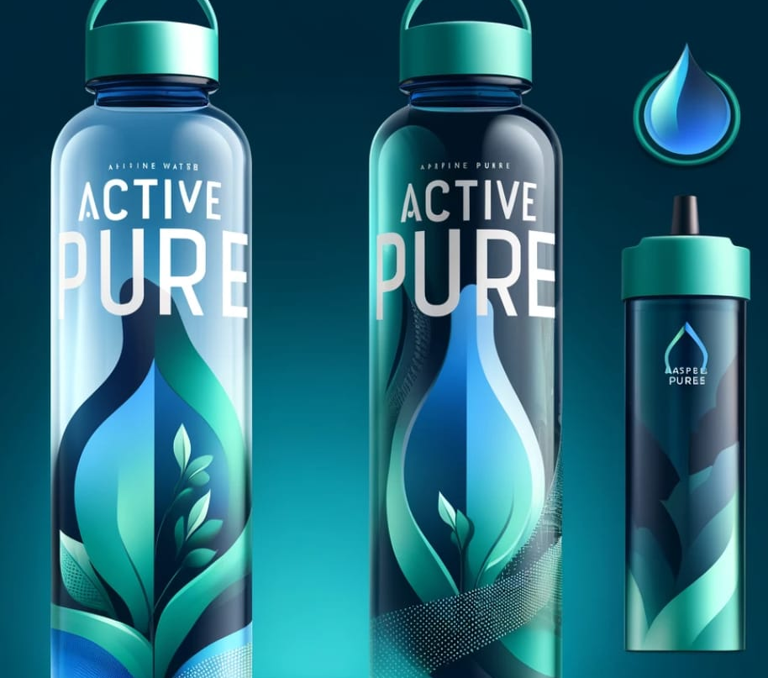
THANK YOU
PRESENTER NAME
EMAIL
WEBSITE

Slide 17
Appendix

Slide 18
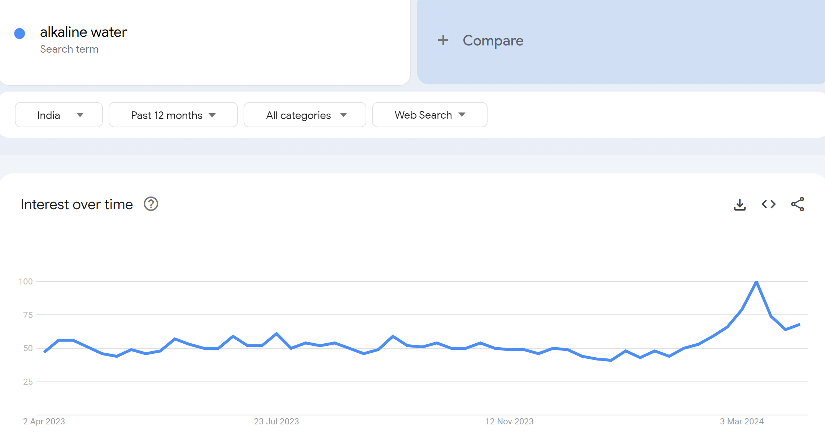
Alkaline water Google Trends

